Slide 1
Project Report
Kernel – Annie 0111279

Slide 2
研究目標 – 長程
優化scheduler
-> 使各個cpu溫度平衡(各cpu溫度的 升高速率)以增進整體performance

Slide 3
研究目標 – 長程
Schedule
Algorithm
2
Update
Adaptor
scheduler
Imbalance
Check
temperature
balance
1
Require Tlast
Return Tlast
Thermal
model

Slide 4
Scheduler
考慮各
個cpu
的位置
與性質
當溫度衝到threshold的時候, 進行task 的migration
排程結果
或
任務遷移結果
更新溫度
相關參數
schedule
migration

Slide 5
Schedule
需考慮linux作業系統本來就有在利用各個task的priority做load balance
-> 有可能各個cpu溫度平衡了，各個 cpu的負載卻變得不平衡

Slide 6
migration
各個cpu溫度不平衡時就要migration嗎？
還是衝到threshold在做migration？
-> 可能會發生乒乓效應

Slide 7
Paper reading
論文標題：Performance-Aware Thermal Management via Task Scheduling
- 提出ThreshHot scheduler:
- 先選擇不超過threshold的hot jobs(computation intensive)來執 行，然後再選擇cold jobs(memory intensive)
- 若所有jobs皆超過threshold，選擇hottest jobs
- 因為有DTM，高溫只影響performance，而不影響正常運作

Slide 8
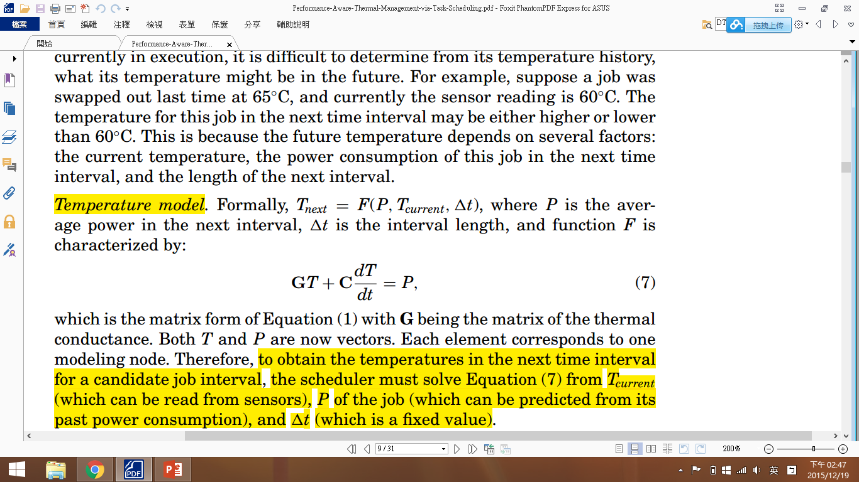
Paper reading
The thermal-aware scheduling algorithm needs information about temperature of processor and power consumption for jobs.
Calculating temperature:
- Thermal sensor readings are not sufficient
- Temperature model:
Calculating power consumption:
- Using performance counters to monitor runtime power consumption
- Power prediction: Last-value-based predictor

Slide 9
Paper reading - how to integrate into Linux kernel
Insert the ThreshHot scheduler into interrupt handler for forcing context switch
- 大約每8ms一次
Context switch overhead
- 通常其實是原本的job繼續被執行
Fairness
- rearrange job slices within an epoch
Impact on nonbatch jobs
- 能做thermal scheduling的jobs都落在batch jobs的priority內

Slide 10
Paper reading – Compare among different algorithms
Greedy scheduler: 先選coolest
Random scheduler
Priority scheduler:
hot jobs priority ↓, CPU time↓; cold jobs priority ↑, CPU
time↑
MinTemp+ scheduler:
>threshold,選coolest job; <threshold,選hottest job
ThreshHot scheduler: hot slice in cool job and vice versa
Note:
需先利用model calibration 將計算值校準到實際測量值
IntReg通常是hottest function unit,所以用其溫度來代表peak temperature
需考慮ambient temperature

Slide 11
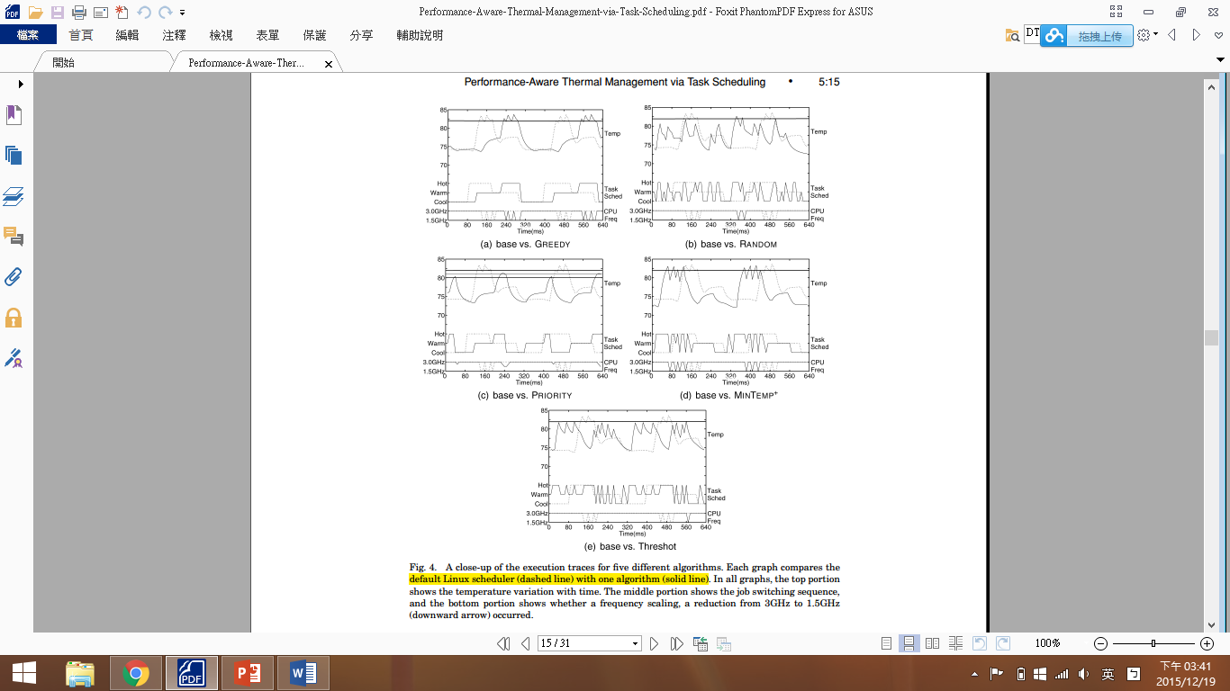

Slide 12
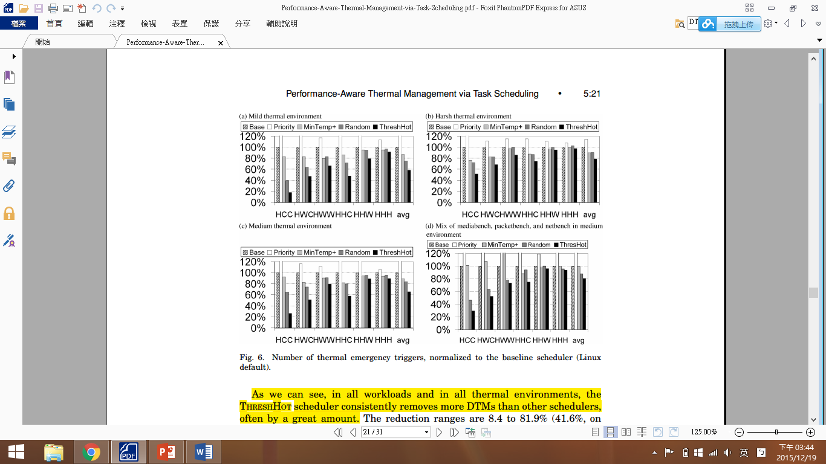
1.
DTMs reduction:

Slide 13
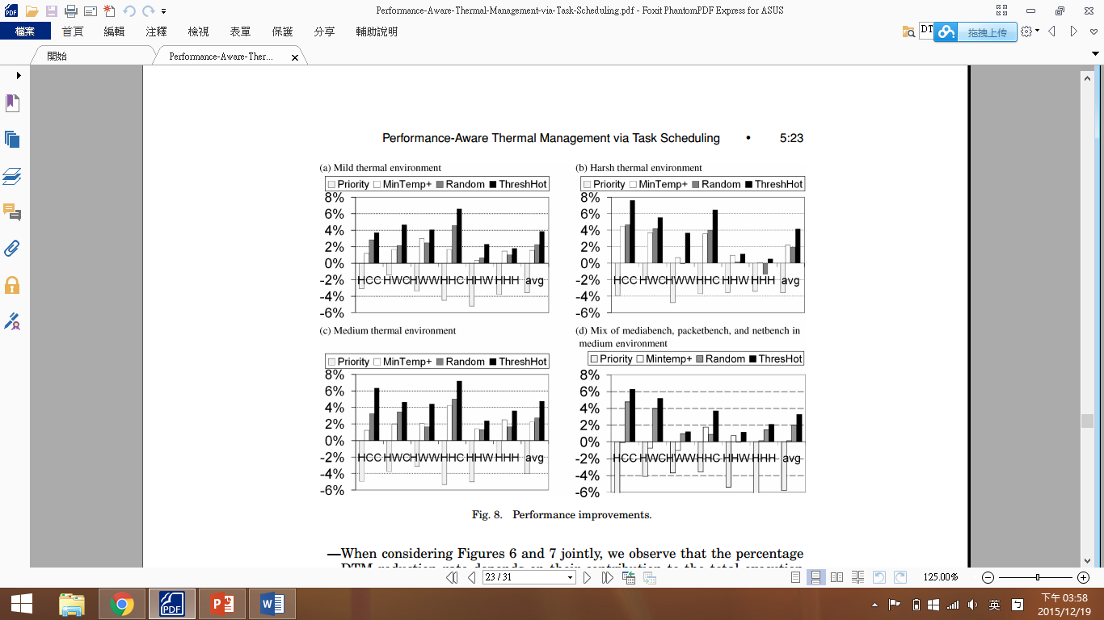
2.
Performance improvement:

Slide 14
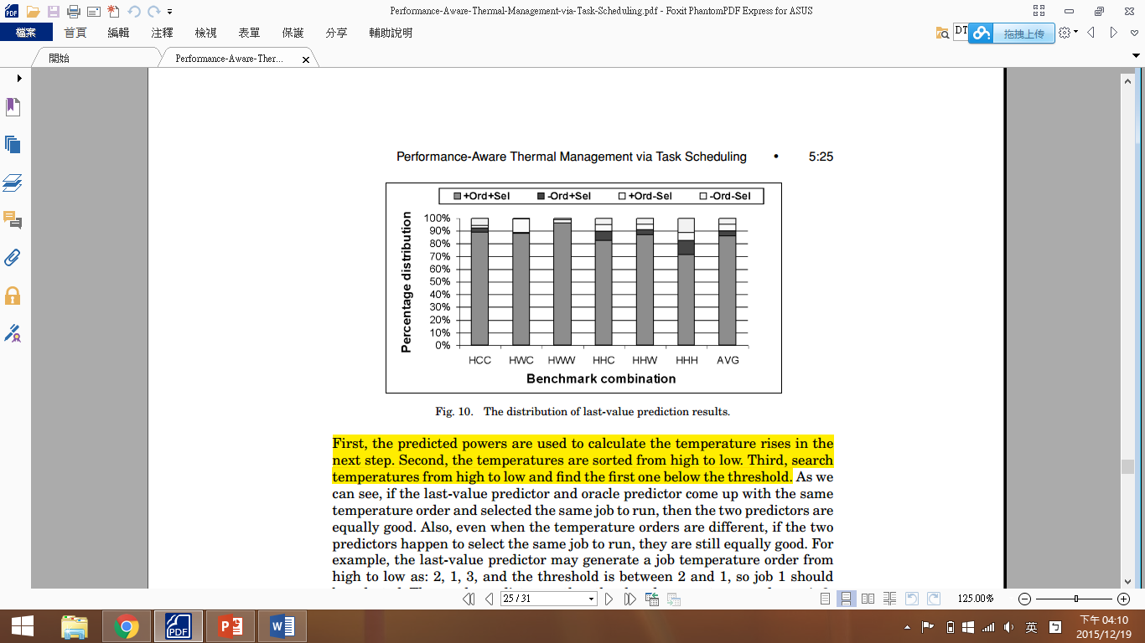
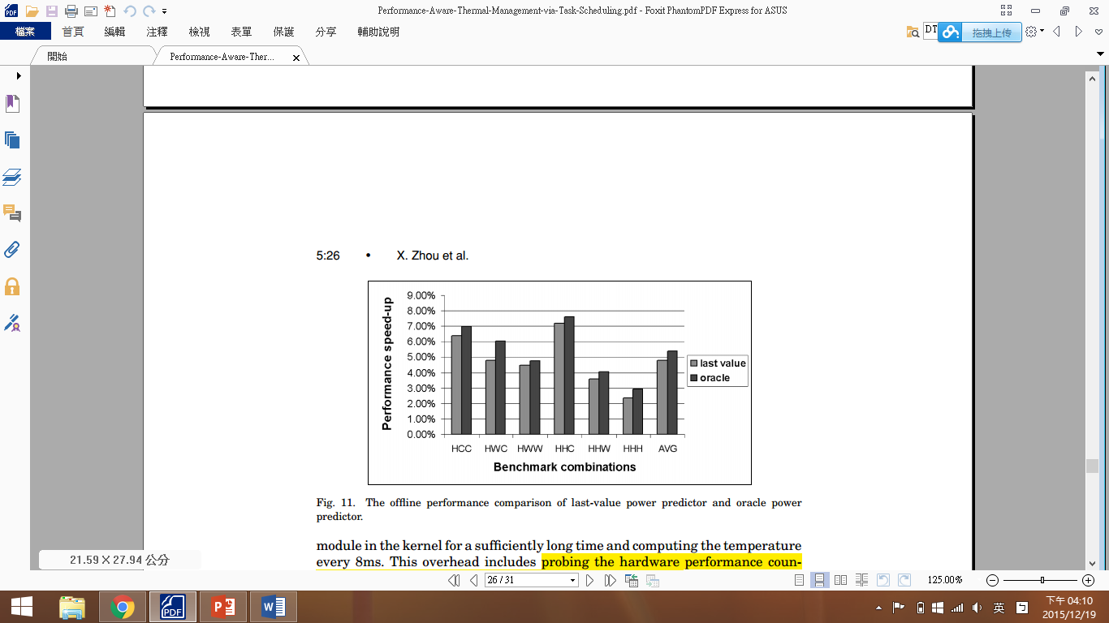
3.
Impact of wrong power prediction:
Last-value-based predictor 的”+Ord+Sel”及” +Ord-Sel”高達90%
Last-value-based predictor 跟oracle predictor幾乎一樣好

Slide 15
4.
Overhead
主要來自temperature calculation及context switch
Scalable scheduler的overhead不隨jobs數量增多而升高
ThreshHot is a scalable scheduler,因為它是將各個job的temperature由高到低排序，再做binary search(O(N)→O(log(N))找出<threshold的hottest job來執行
------------------------------------------------------------------------
★ Paper reading conclusion:
ThreshHot scheduler can increase about 5% of performance and regulate the chip’s thermal behavior at the same time.

Slide 16
研究目標 – 短程
First experiment
Second experiment
100
0
70
10
0
0
10
10

Slide 17
目前進度
安裝好ctags與cscope並了解其環境設定與使用方法
已構思好要如何將本來的scheduler改成imbalance的狀態(完成pseudo code)
參考：OSDI Lab9 spec
build 修改過後的 Ubuntu kernel 成功(可以成功開機，但imbalance尚未達成)
參考：
http://nixchun.pixnet.net/blog/post/9690040- compile-the-ubuntu-kernel

Slide 18
Pseudo code – load_balance內
if(this_cpu==0){ //cpu=smp_processor(), 該funciotn返回當前處理器的編號
if(cpu_rq(1)->nr_running > 1){
//ex: cpu_rq(1)返回cpu1的rq
//nr_running : 處理器rq執行的task(s)的數量
detach_tasks(…); //move cpu1的task(s)到cpu0
}
}

Slide 19
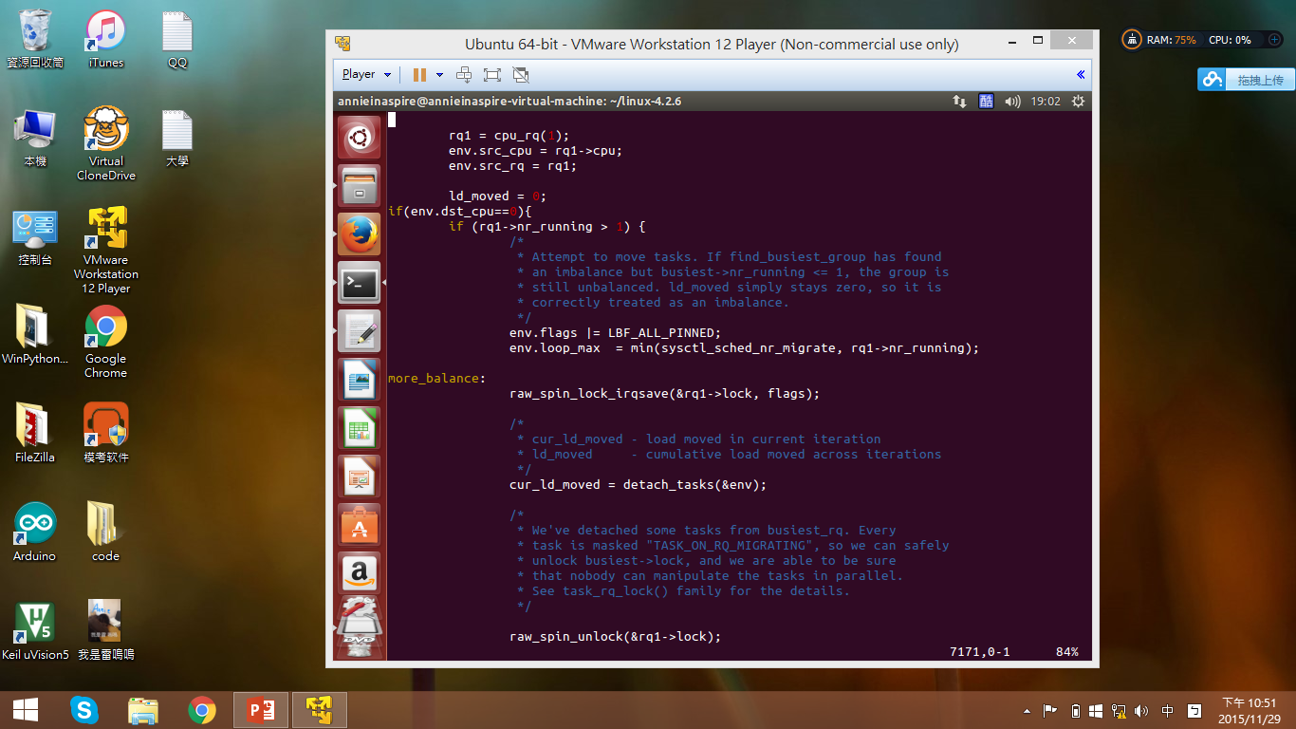

Slide 20
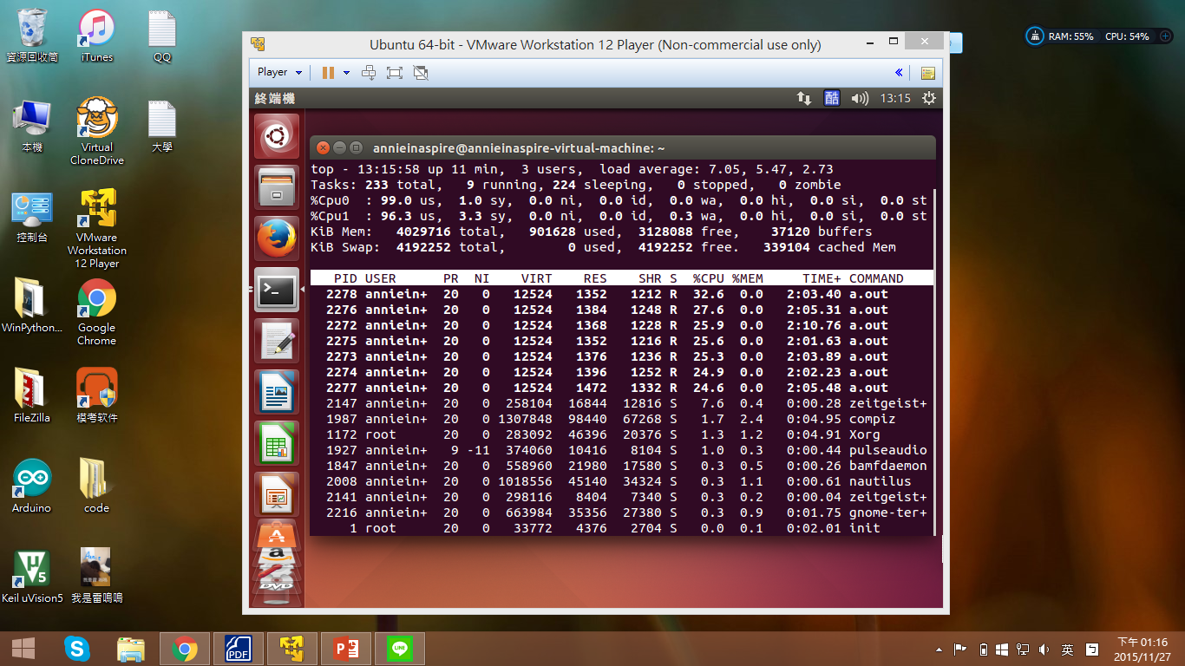

Slide 21
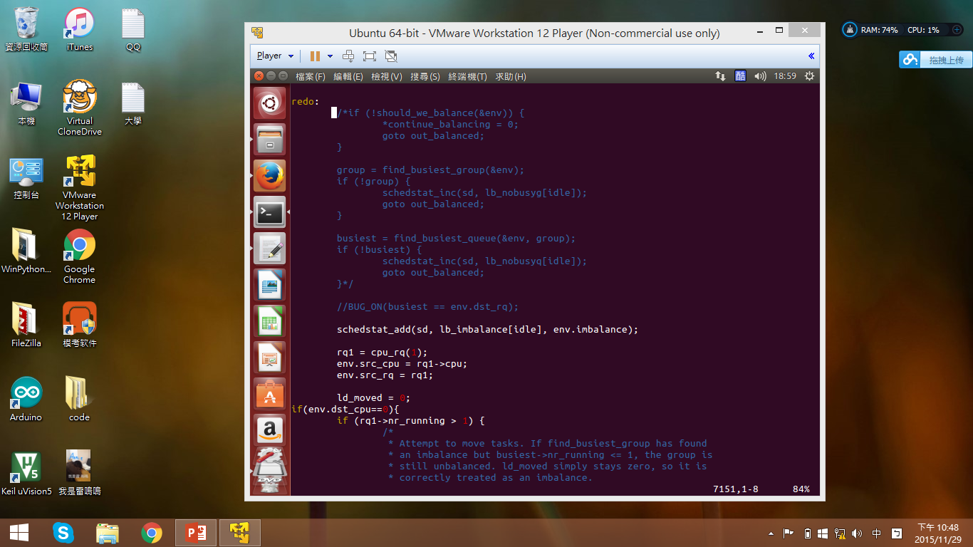

Slide 22
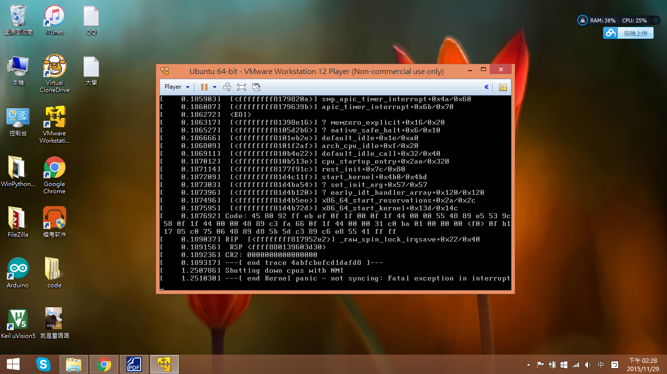

Slide 23
預計進度(complete first experiment)
Realize the pseudo code
Build, install and run the new kernel with an “Imbalance” scheduler
Test
-> Using command “top” and then press “1”
Or
-> Using command “htop”

